Slide 1
Hello! My name is Dessa.
I’m here to help you to learn Business Intelligence.
What do you want to do?
Ask questions about BI topics
Do quiz
Review quiz questions
You can only review questions which you already solved

Slide 2

What would you like to know?
See most popular questions
Go back

Slide 3
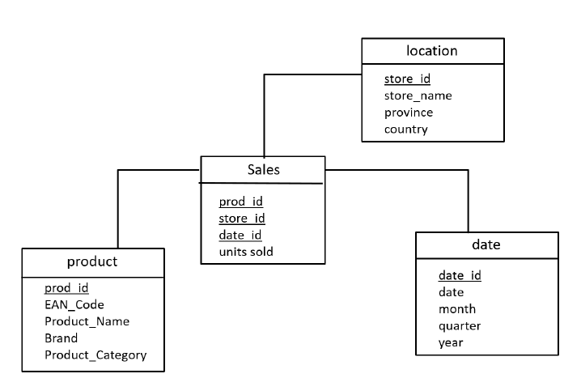
What would you like to know?
What is a star schema?
A star schema describes the implemen-tation of a multidimensional model in a relational database. See an example below: (opens on click)
Find more information in this primer
See most popular questions
Go back

Slide 4
What is a star schema?
What does true to the grain mean?
What is the difference between
...
...
Go back
Exit

Slide 5
Please, tell me which is important when you model a data model for analytical processing. You can choose several:
Simple design to support schema updates and discussion with business stakeholders
Fast answers to (complex) queries
Consistency of data after selection
High transactional throughput
Accurate description of the real world
Simple design to support schema updates and discussions with business stakeholders
Go back
Exit

Slide 6
Please, tell me which is important when you model a data model for analytical processing. You can choose several:
Simple design to support schema updates and discussion with business stakeholders
Fast answers to (complex) queries
Consistency of data after selection
High transactional throughput
Accurate description of the real world
Simple design to support schema updates and discussions with business stakeholders
Go back
Exit

Slide 7
Fast answers to (complex) queries
Accurate description of the real world
Simple design to support schema updates and discussions with business stakeholders
This is correct, well done!
Do you want to discuss the solutions further or go to the next question? Please choose:
Next question
Discuss solutions
Go back
Exit

Slide 8
This is correct, well done!
Do you want to discuss the solutions further or go to the next question? Please choose:
Next question
Discuss solutions
Next question
Go back
Exit

Slide 9
This is correct, well done!
Do you want to discuss the solutions further or go to the next question? Please choose:
Next question
Discuss solutions
Discuss solutions
Go back
Exit

Slide 10
See you next time!

Slide 11
Archive

Slide 12
In the newspaper from the previous question, the team lead has formulated the strategic goal “make the mobile app more innovative”. Consider the following alternative KPIs that have been proposed to measure achievement of this goal
KPI 1: number of app downloads after new release / number of app downloads before release
KPI 2: number of user sessions where a newly introduced feature has been used / total number of user sessions
KPI 3: absolute number of new features in the app
KPI 4: absolute number of new features in the app that have been approved by the team lead

Slide 13

Additional note
Learn Why: X and Y
The query translates into: show me number of quality issues (X) per supplier (Y). X is the dependent variable and Y the independent.
Typical analytical questions can often be decomposed into a numerical variable (X), which is counted or summed up along the values of one or more categorical variables (Y)
For more information read “A short primer of multidimensional modeling” on moodle.
Exit quiz

Slide 14
Additional note
Learn Why: important aspects for data modelling
Fast answers to complex queries
When translated into e.g. a database schema, the mode lshould guarantee efficiency in terms of:
–Query throughput, i.e. efficiency of read operations
–Transaction throughput, i.e. efficiency of insertion, update and deletion operations
–Disk space consumption
Simple design to support schema updates and discussion with business stakeholders
The model should be as easy to understand and as simple as possible. This helps to implement the model, but even more to maintain and update it later when it might become necessary
Accurate description of the real world
False information leads to wrong business decisions
For more information read “A short primer of multidimensional modeling” on moodle.
Next Question
Exit quiz

